Slide 1


Angular Final Project
Kousalya. R
19001189

Slide 2
Abstract :
Amazeee art works displays the collection of artworks according to the theme ,artist types and pricing of it which will be available in offline artwork gallery. It has User side and Admin side where admin can add product, delete ,edit and update, and answer the forum, user can look on it, review it and suggests what is required more.

Slide 3
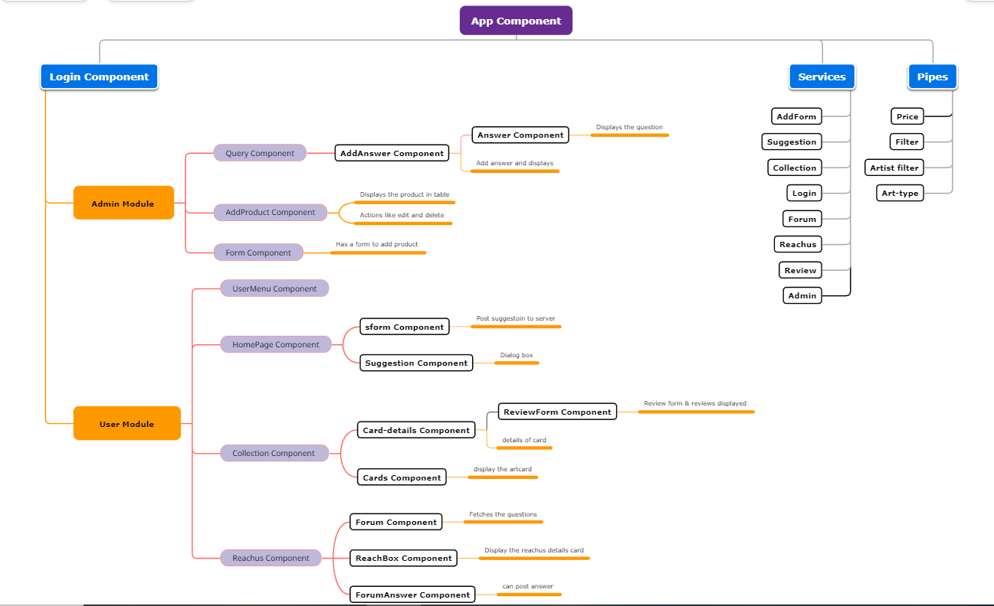
Flow Chart:

Slide 4
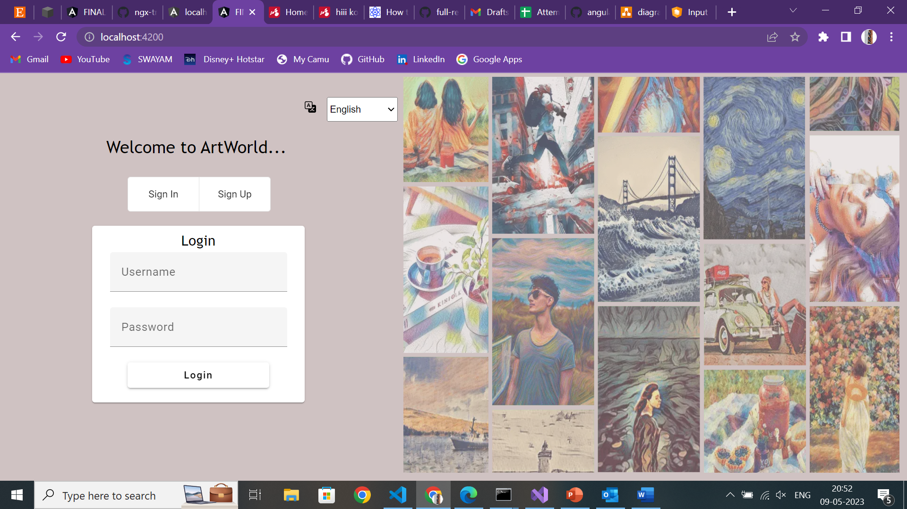
Defaultly Login Page Appears
Used:
Template based approach
Internationalization
Lazy Loading
Angular Material
Toggle Button
Button
Cards
Form Field

Slide 5
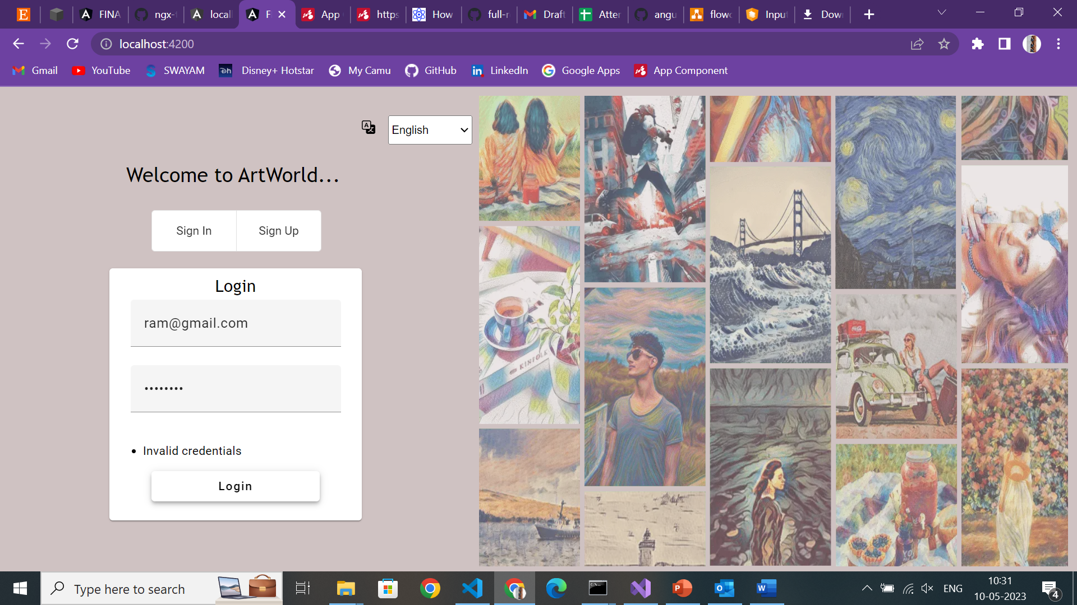
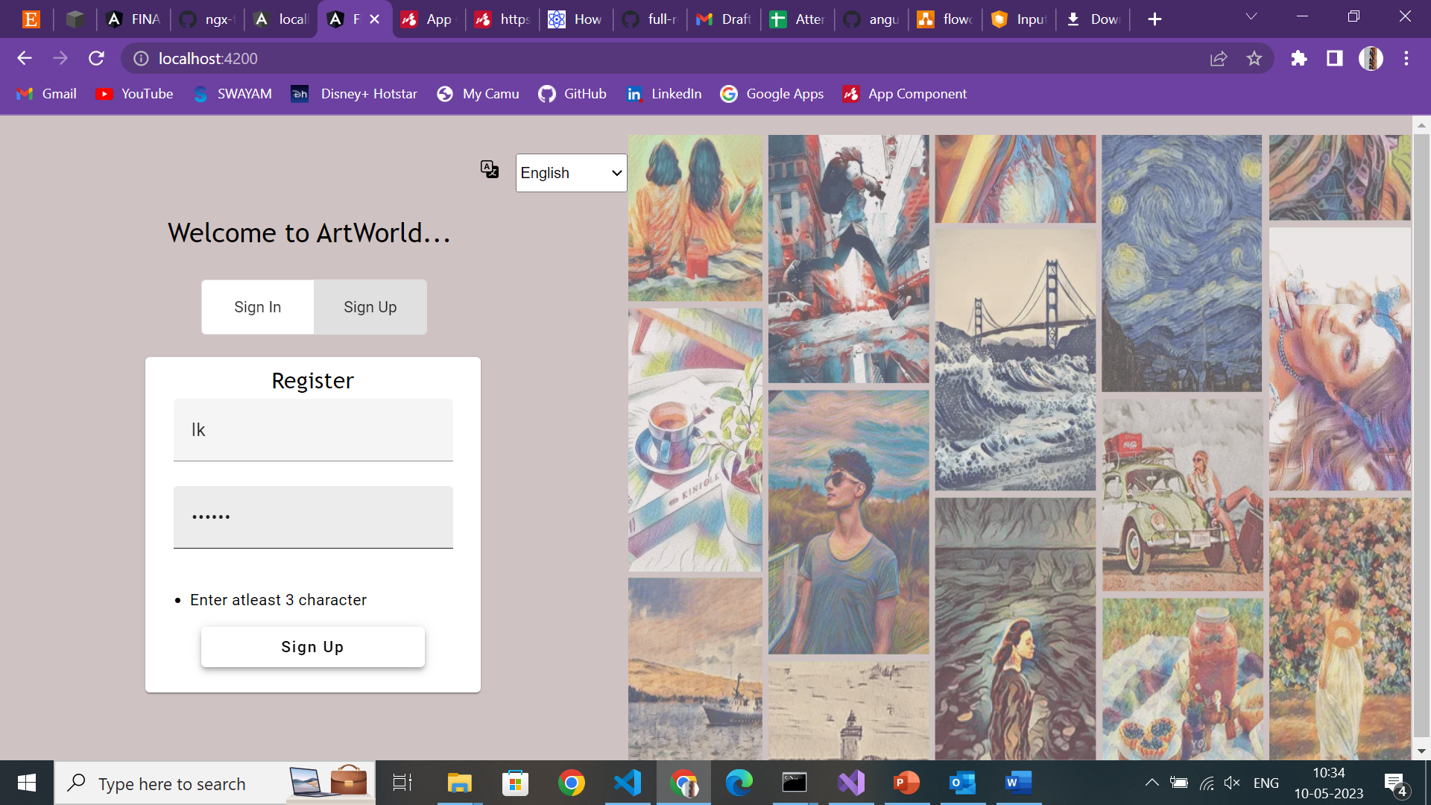
When invalid credentials are given ,it notifies the user
When Registering new user, validation are kept.

Slide 6
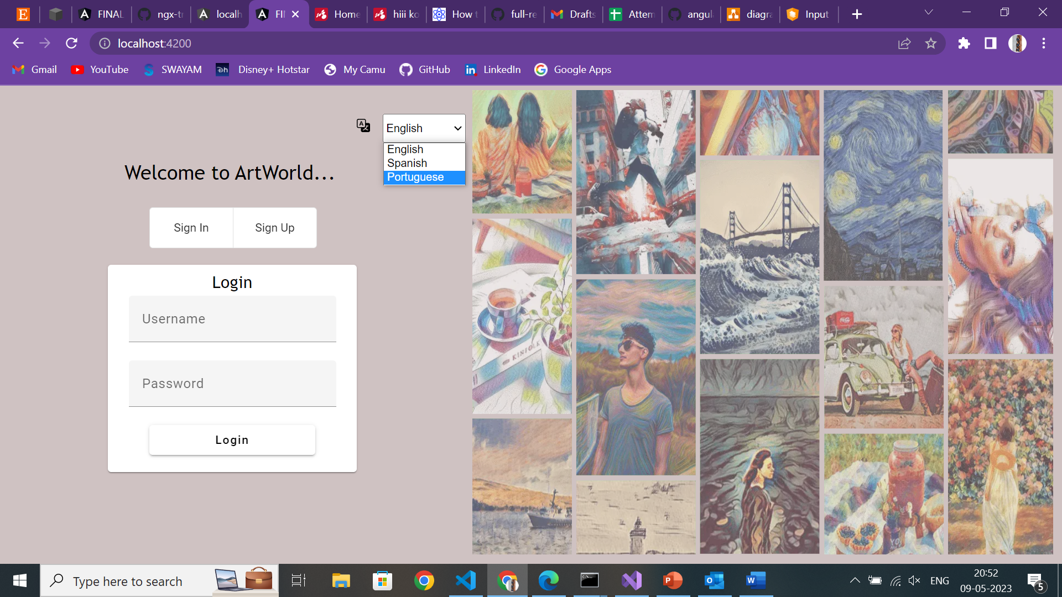
Internationalization of 3 languages,which changes the language for the login page

Slide 7
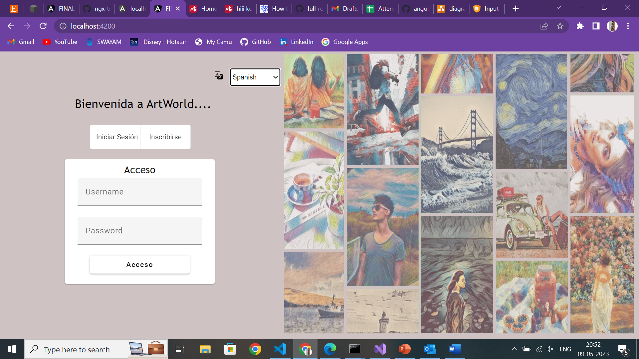
When Spanish is choosed,it gets changed

Slide 8
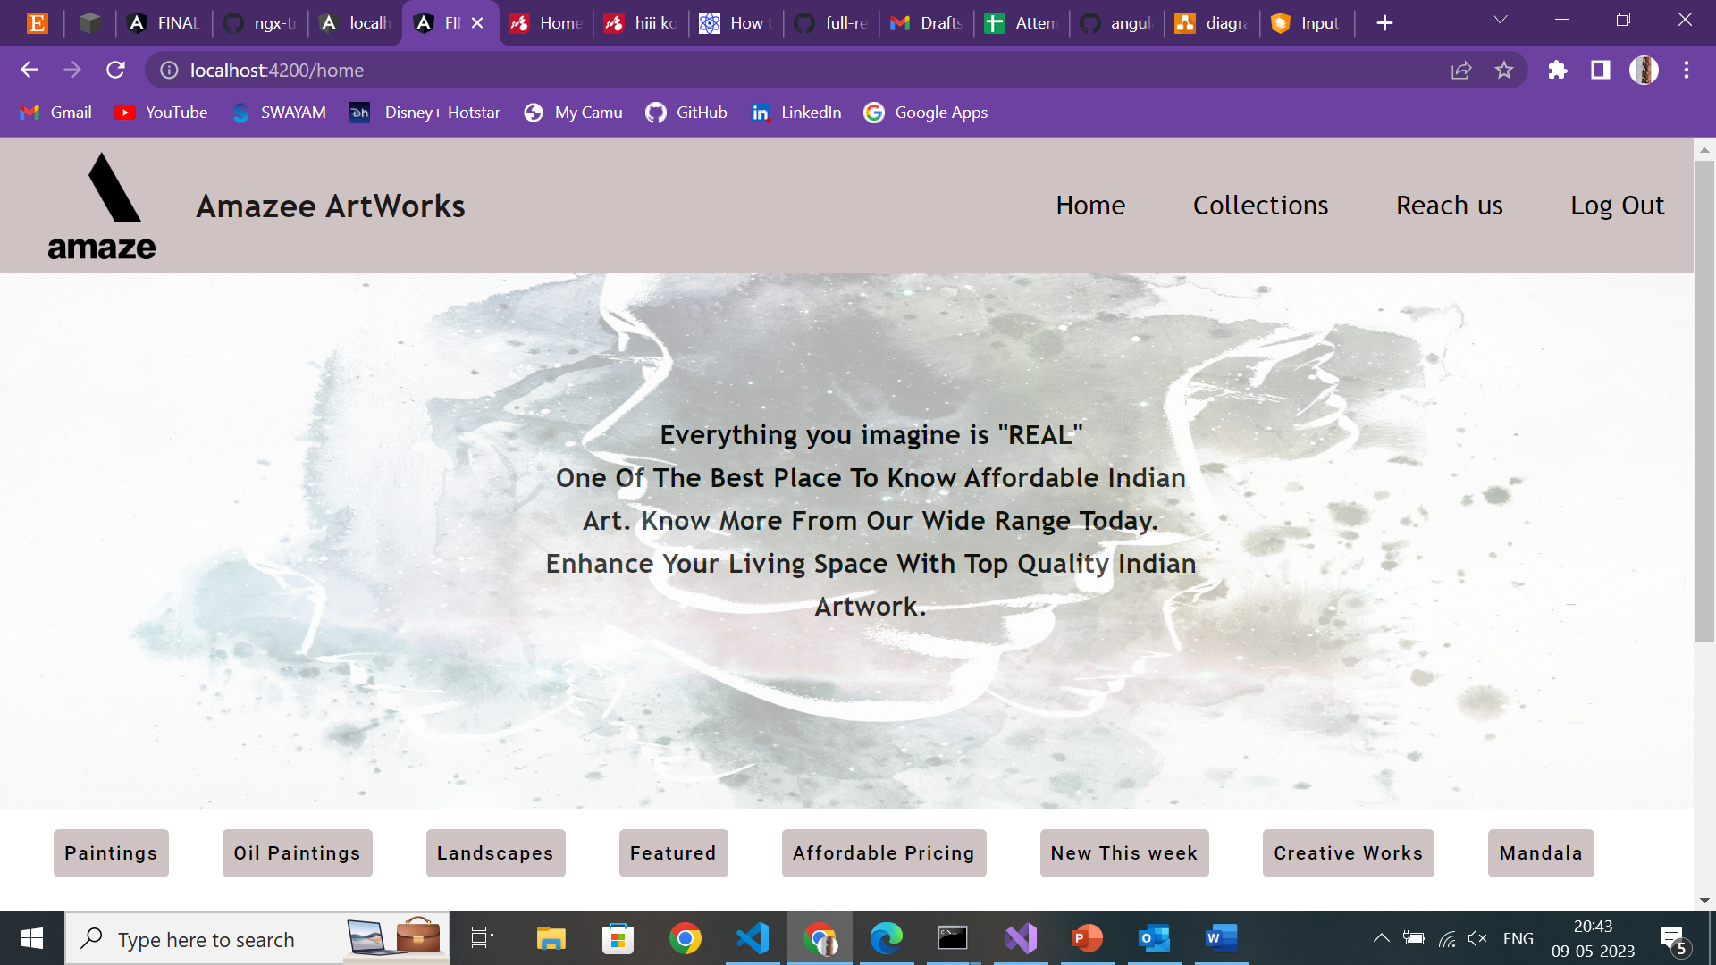
When logged in successfully,Home page displays, (User Side)
Used:
Slideshow
Routing for each tab

Slide 9
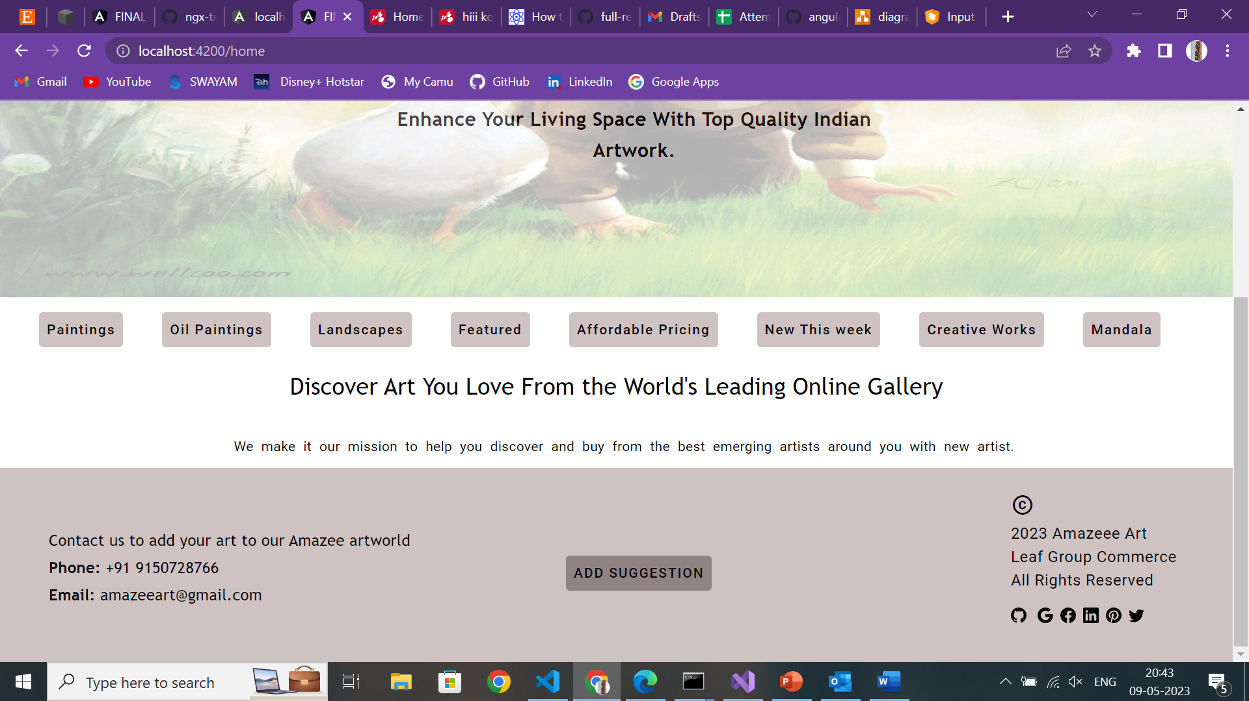
User can add their suggestion by clicking add suggestion
Used:
Dialog material
Bootstrap Icons

Slide 10
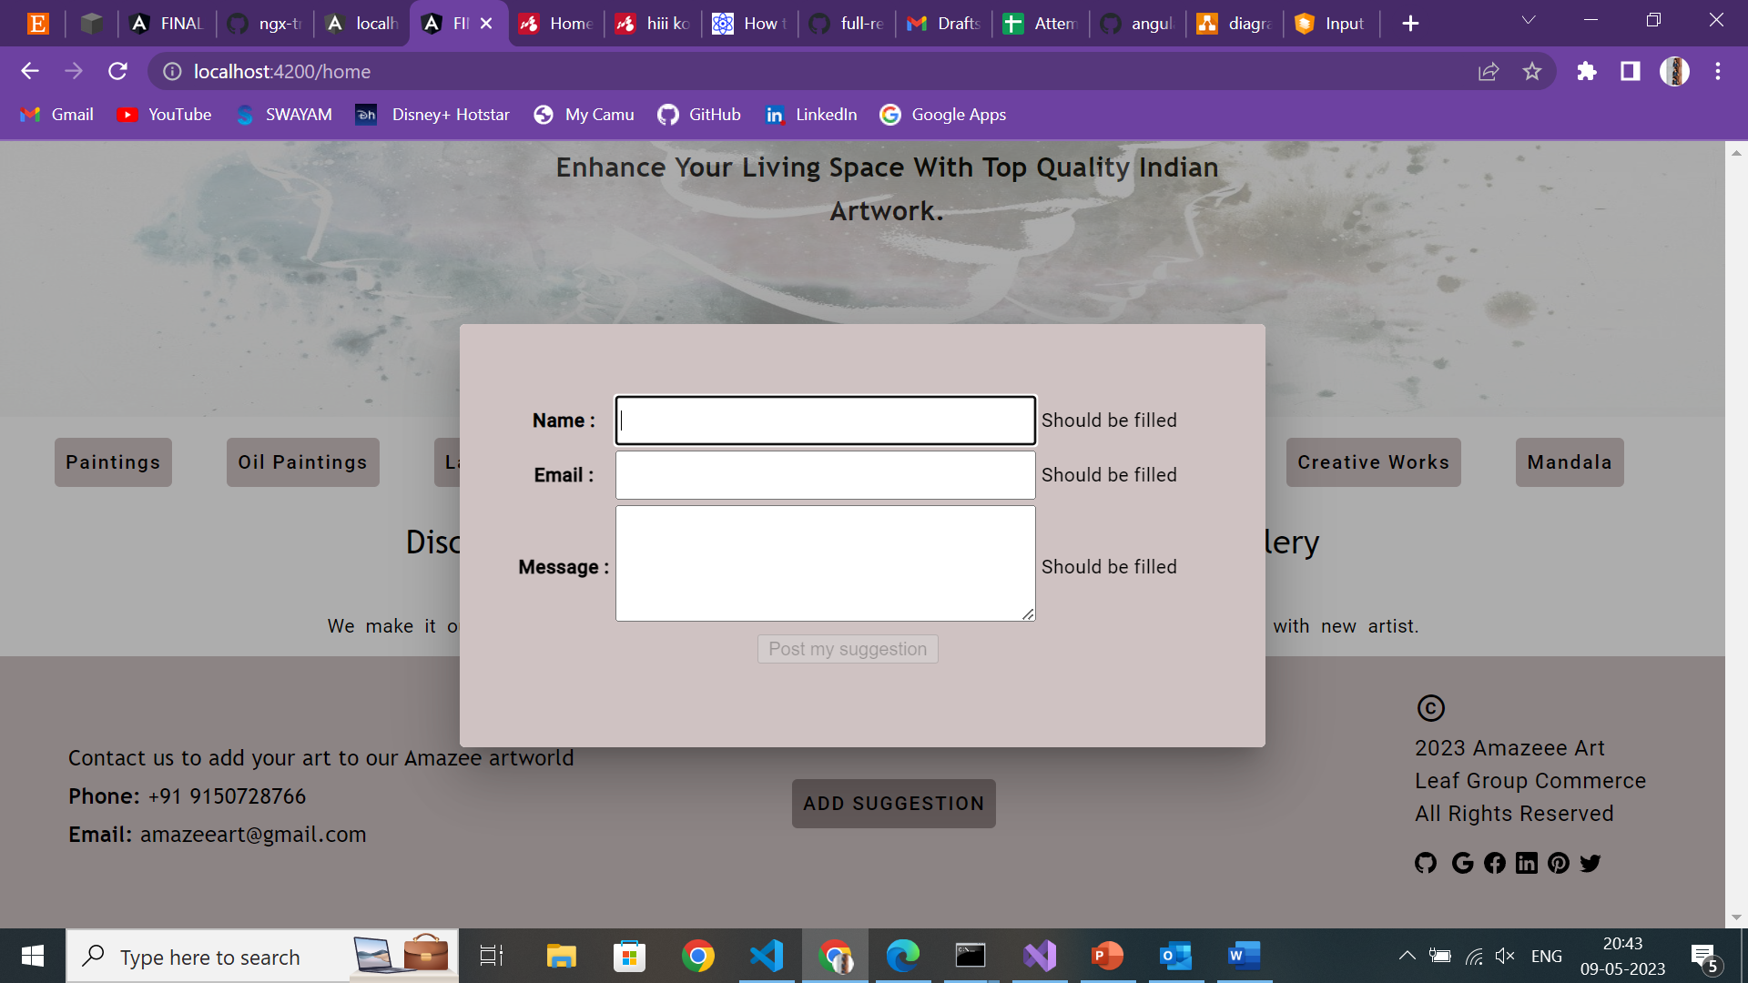
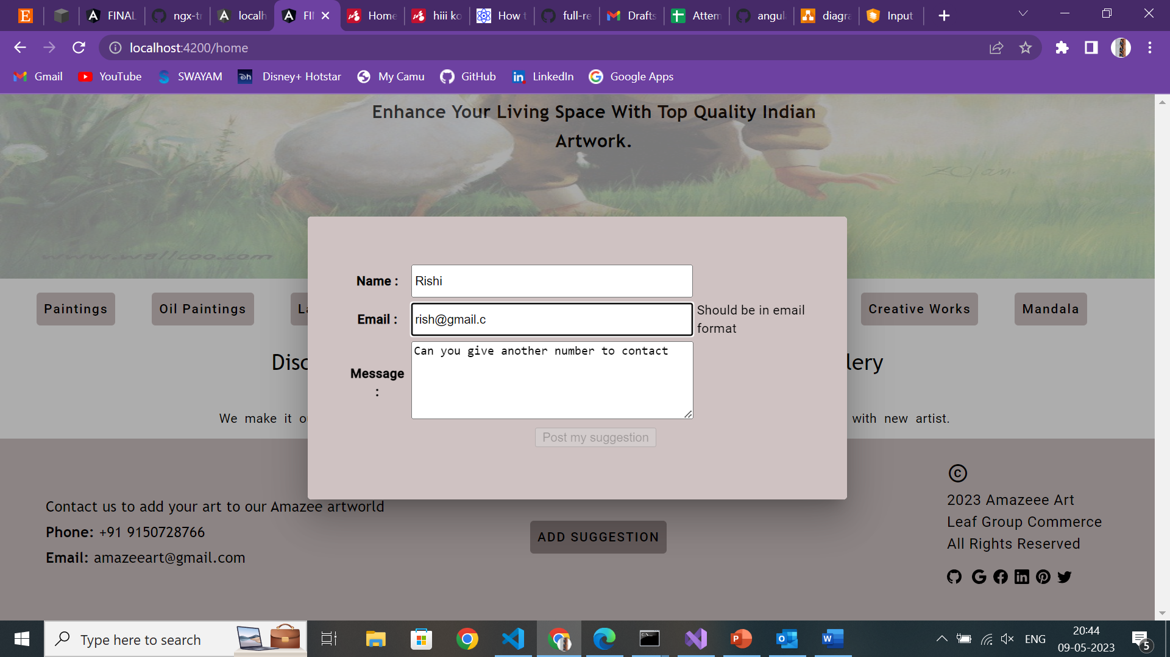
Suggestion form
Used :
Model based approach
Validation created
3. Directives

Slide 11
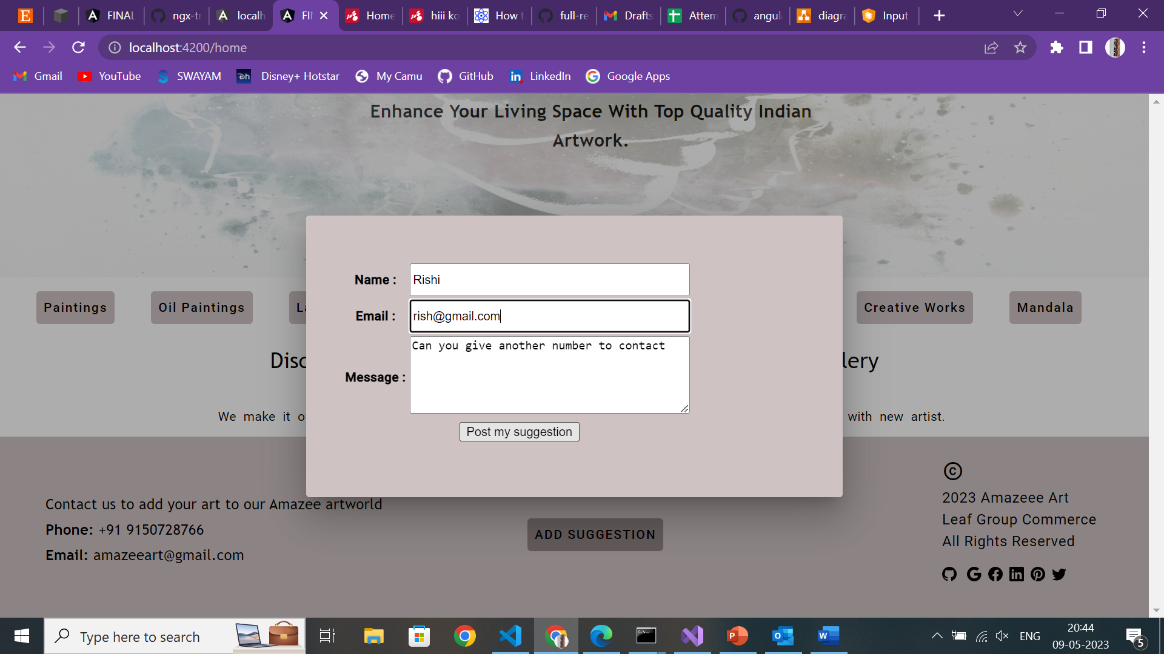
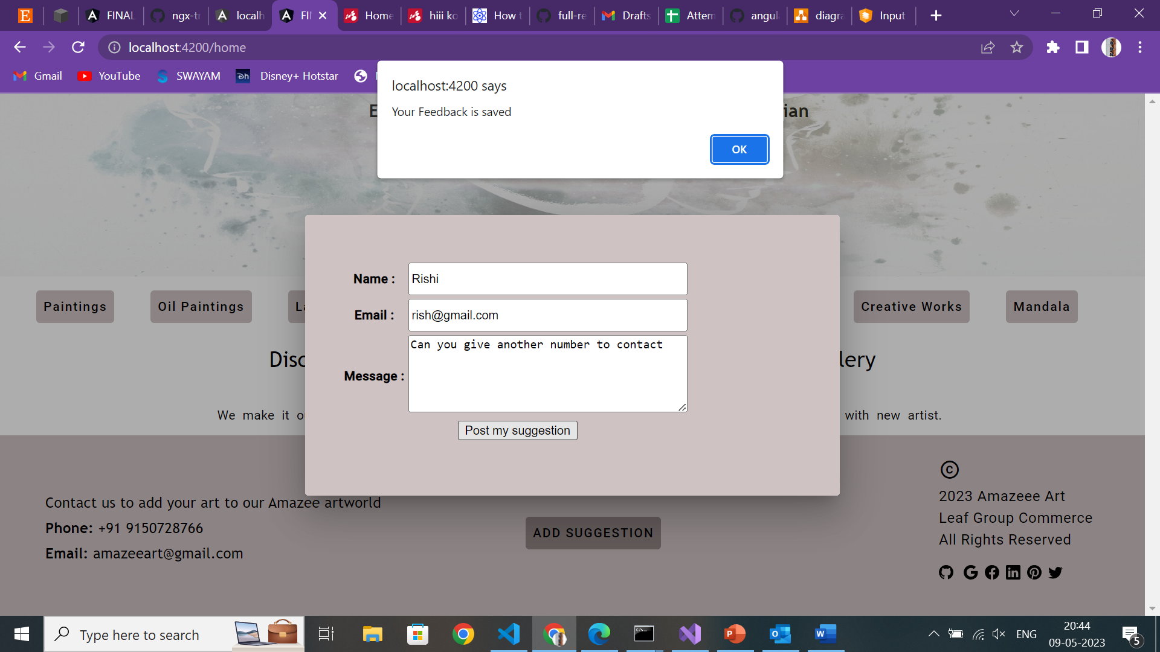
Posted to json-server
Used:
Directives
Post method

Slide 12
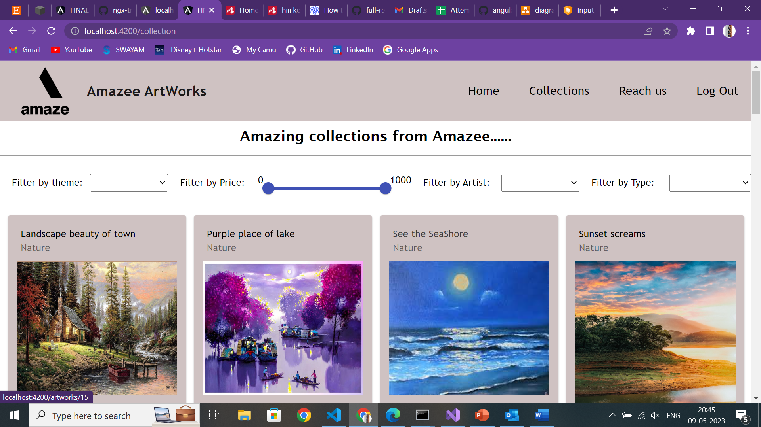
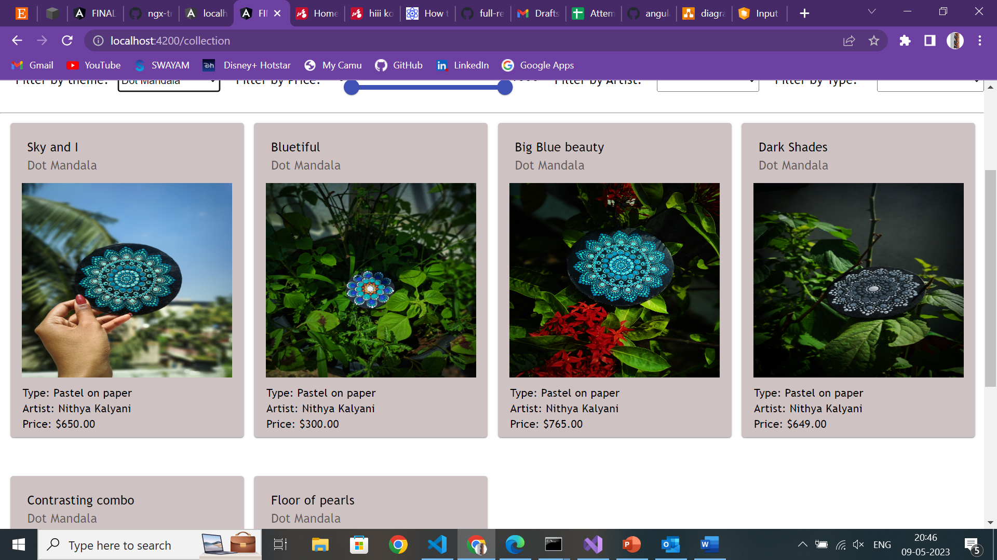
Collection Page
Used:
Filters –pipe
Price range –pipe
Mat cards
Directives
Get Method

Slide 13
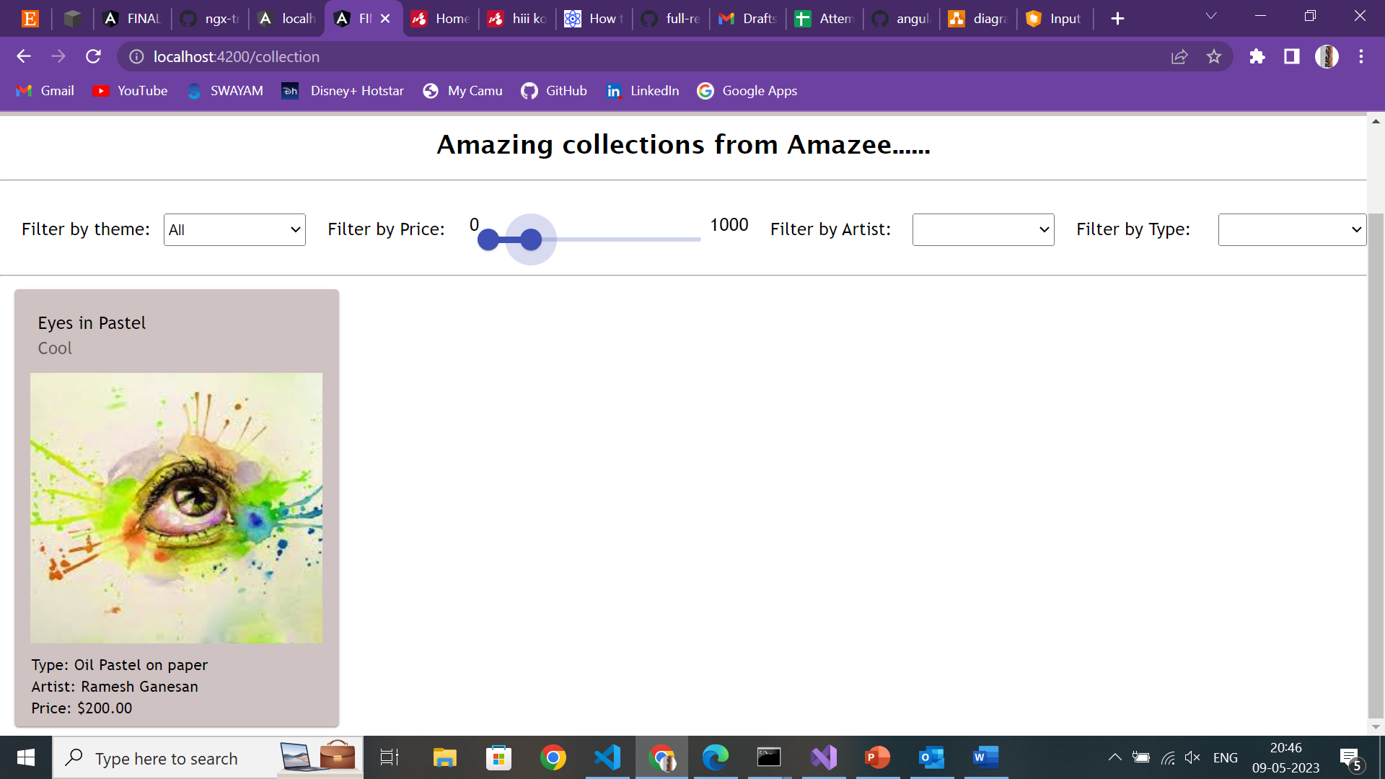
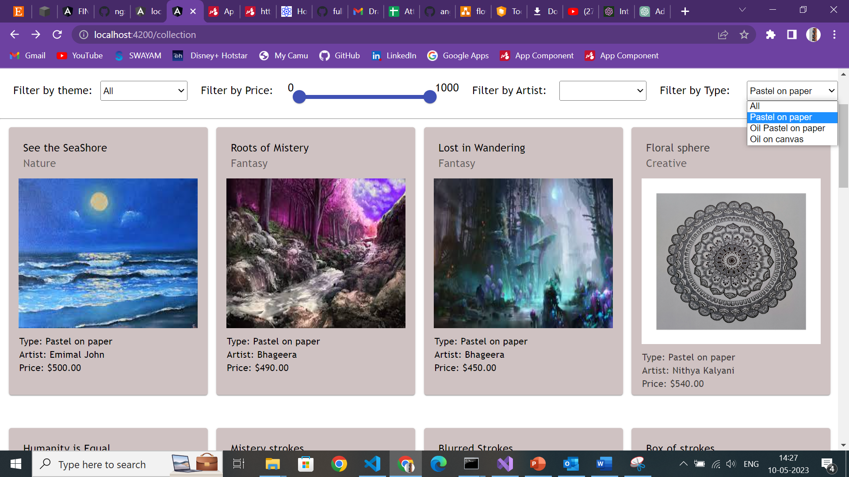
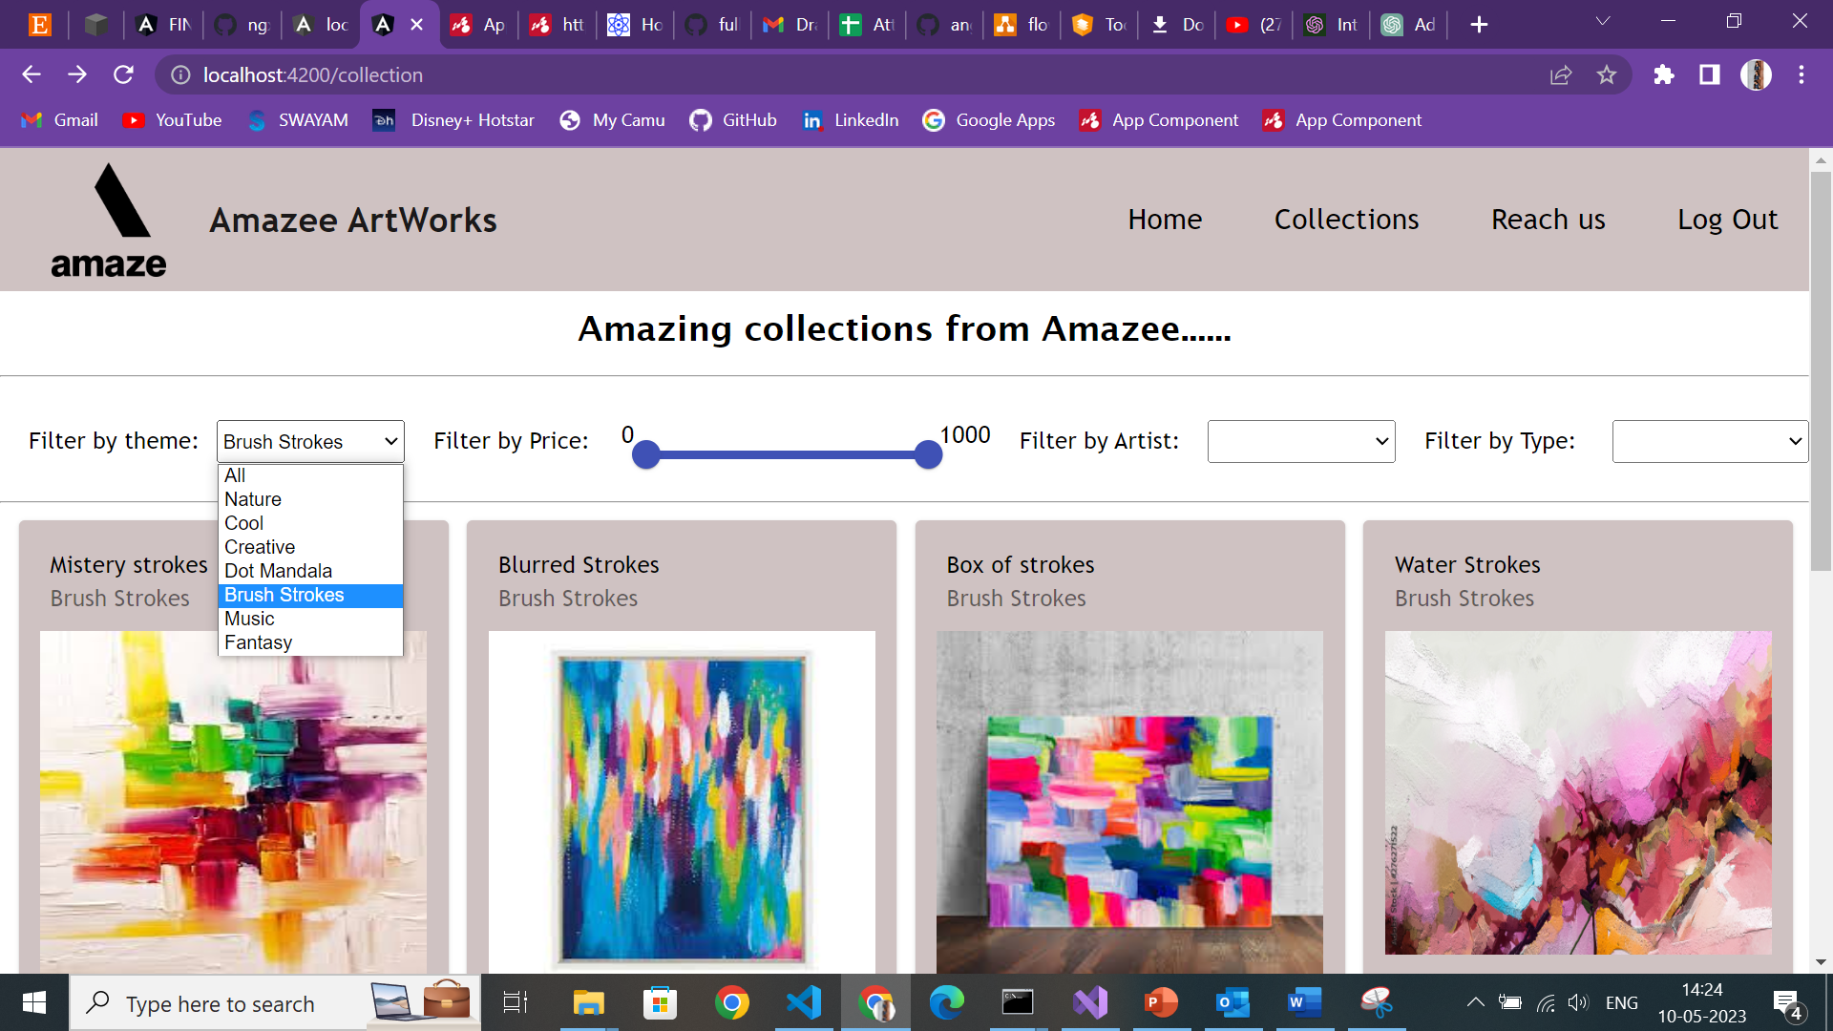
Filtered using price and filter

Slide 14
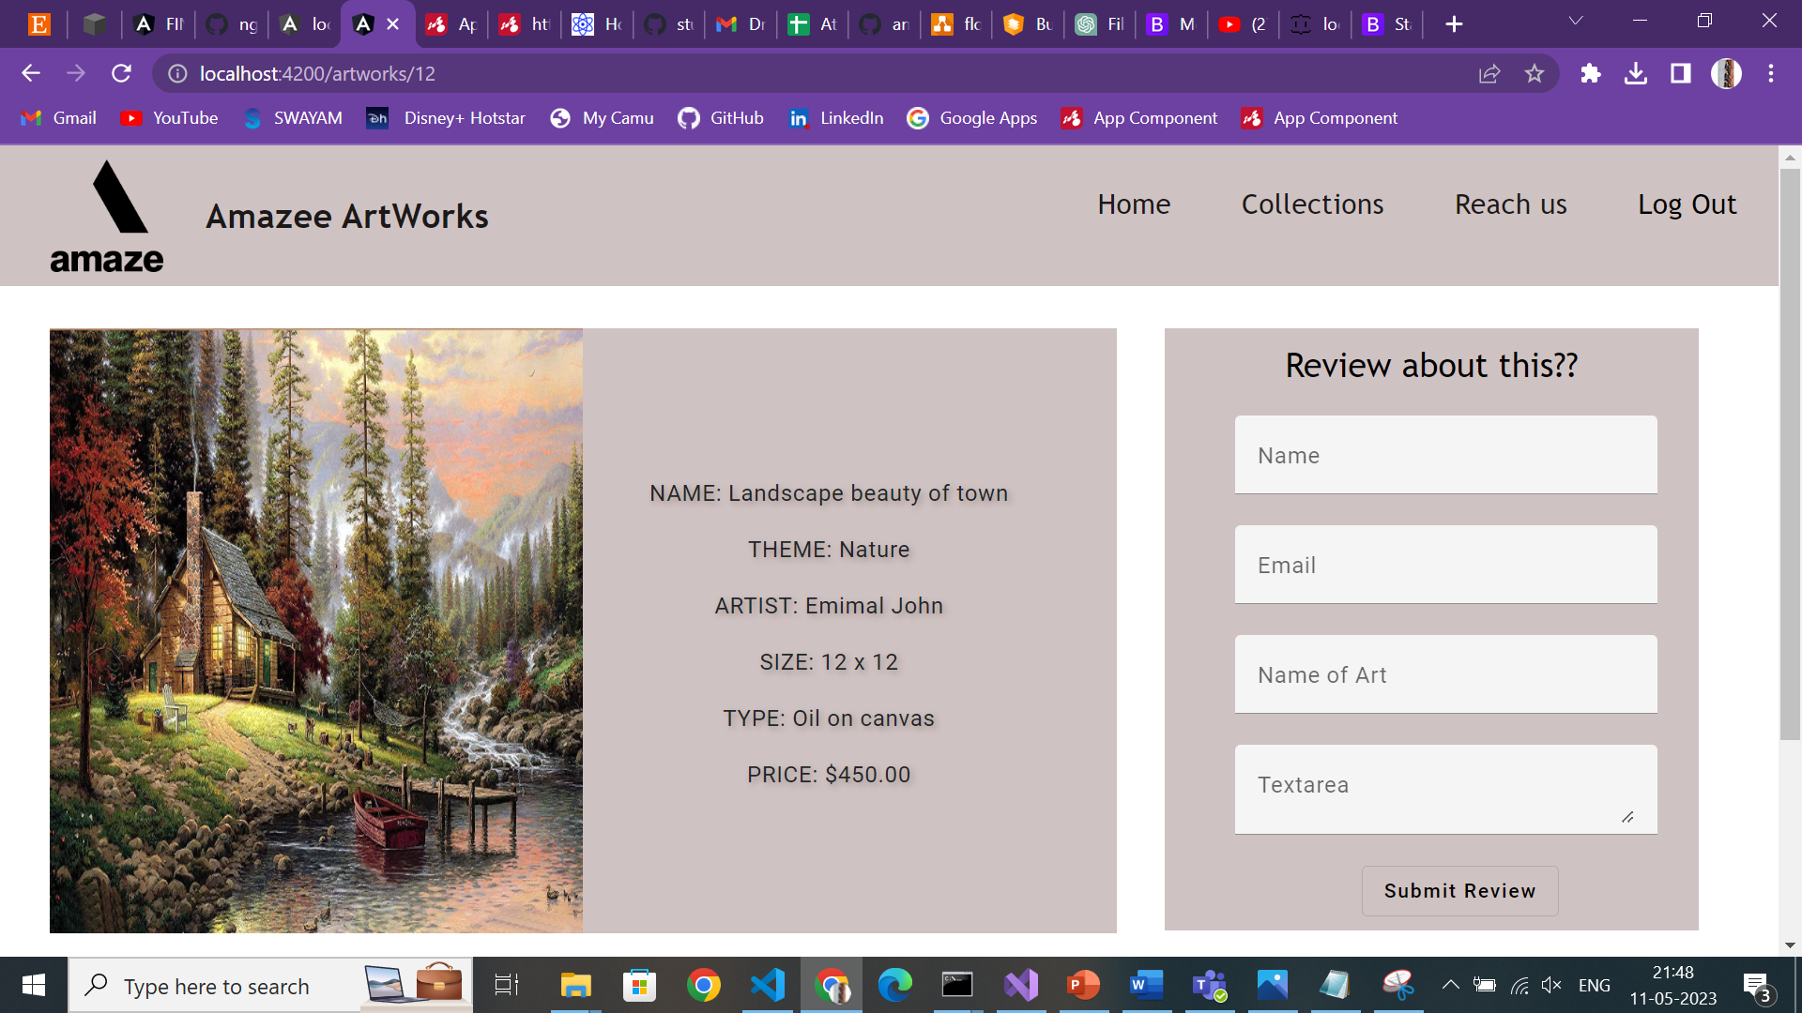
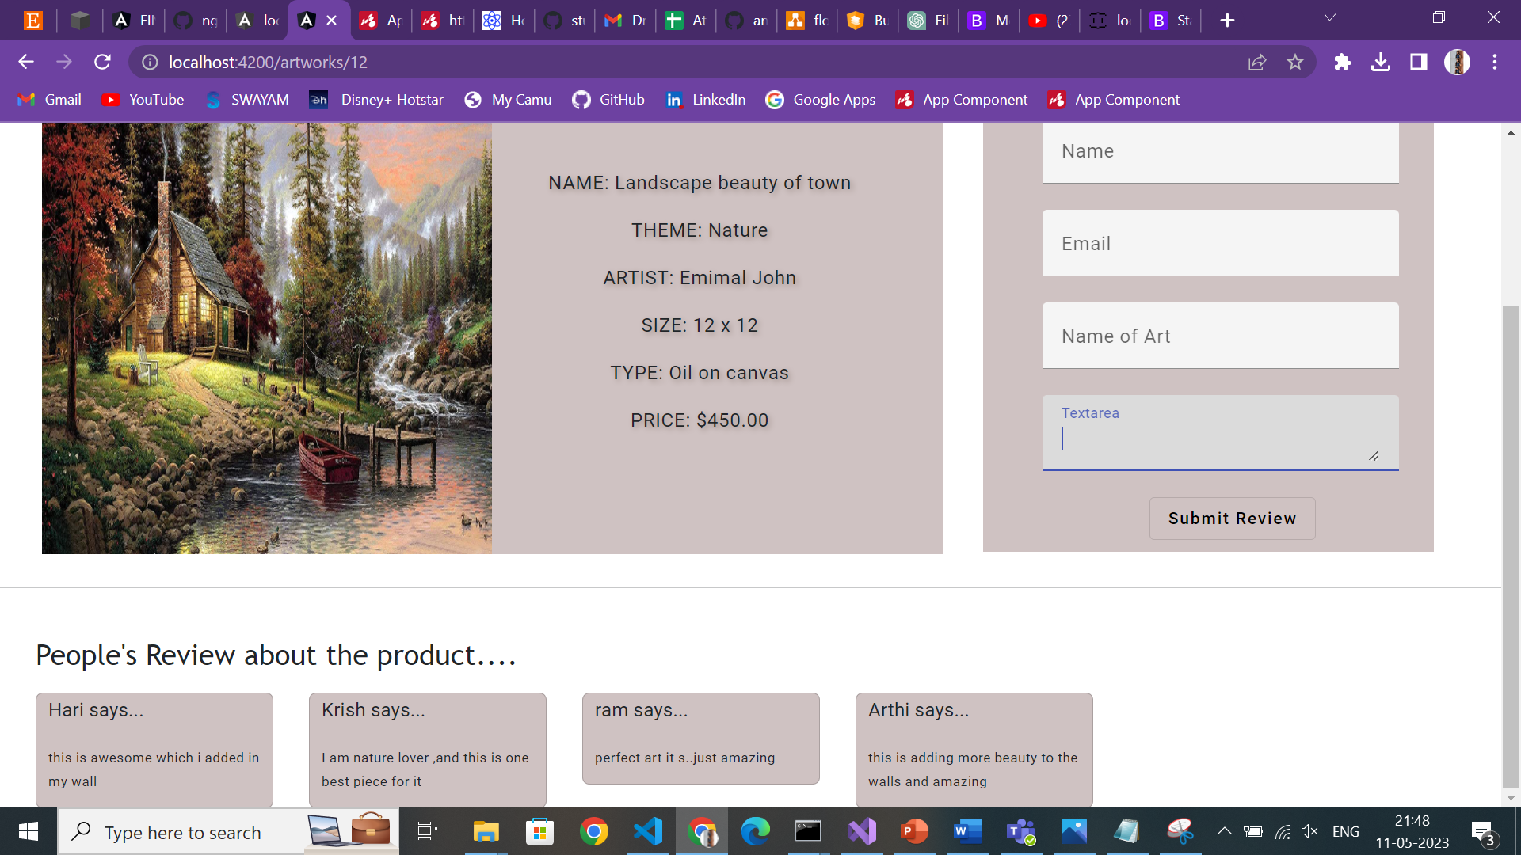
When the card is clicked,it displays the details and through the review form user can post their reviews
Used:
Template based approach
Directives
Post method
Get method

Slide 15
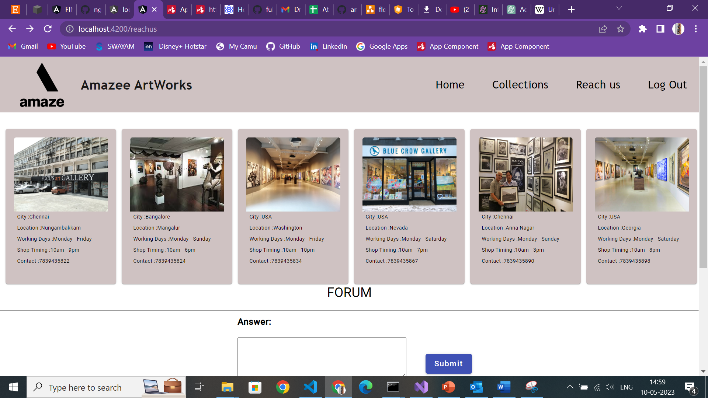
Reachus Page
Used:
Mat card
Get Method

Slide 16
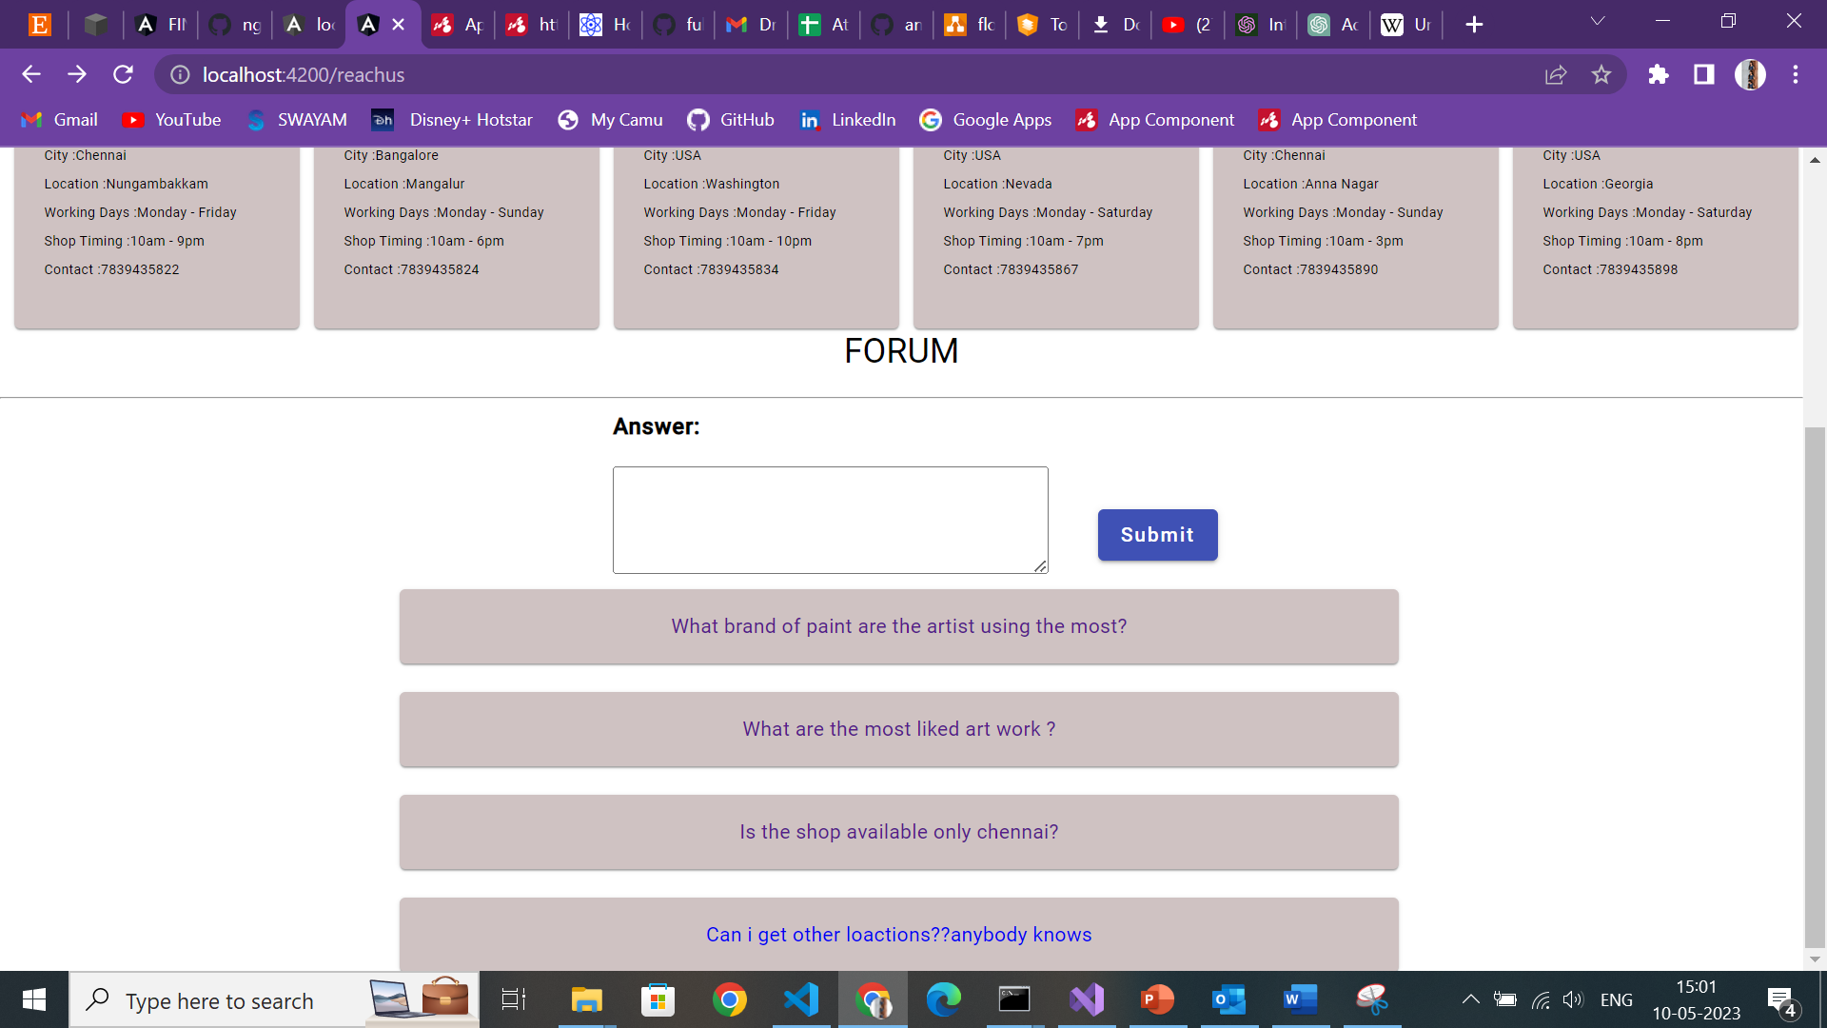
Forum
Used:
TextBox
Output Directive
Get Method

Slide 17
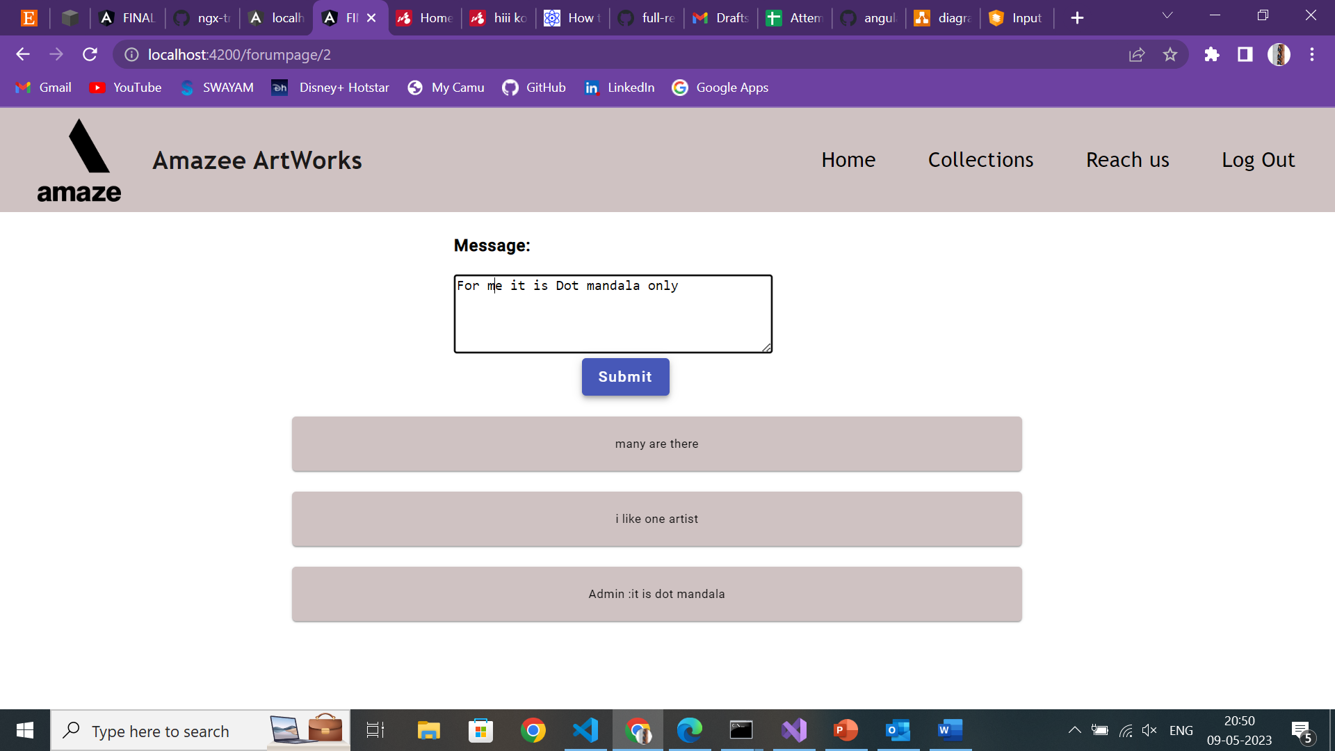
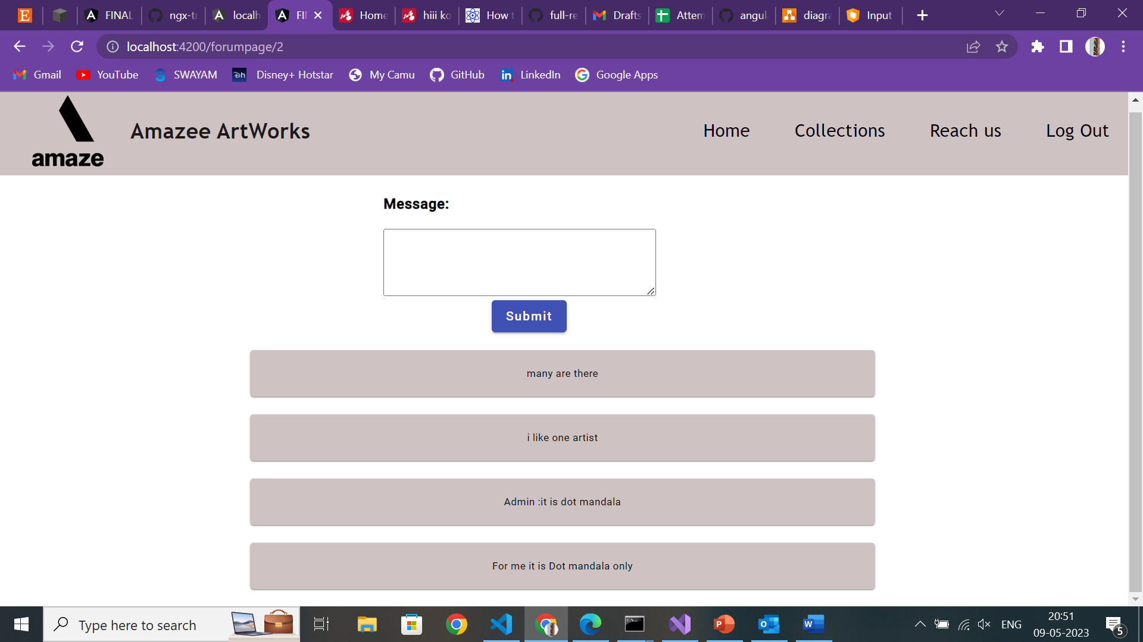
Used: 1.Put method 2.post method 3.Mat cards 4.Output Directive
Forum Answering page

Slide 18
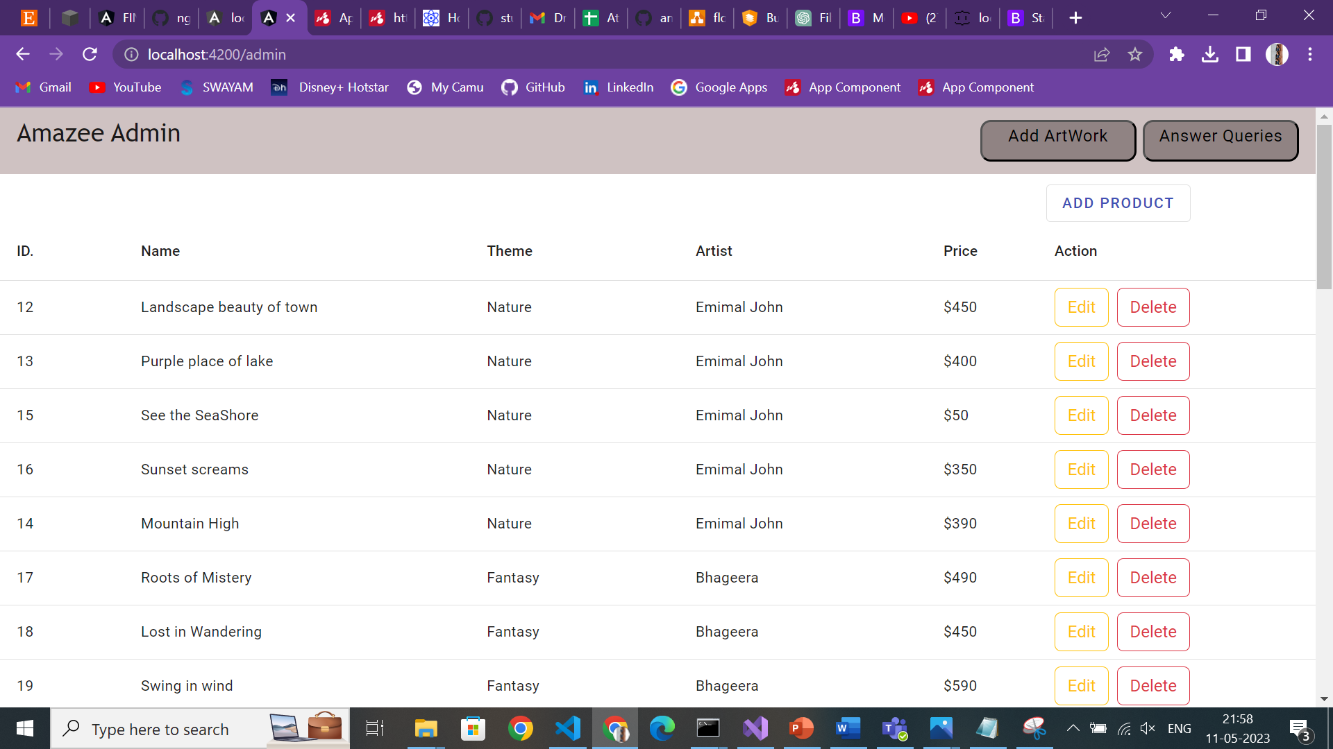
Admin Side-Add Artwork Tab
Used:
Add Product action
Edit Product action
Delete Product action
Bootstrap dialog modal
Template Based Form

Slide 19
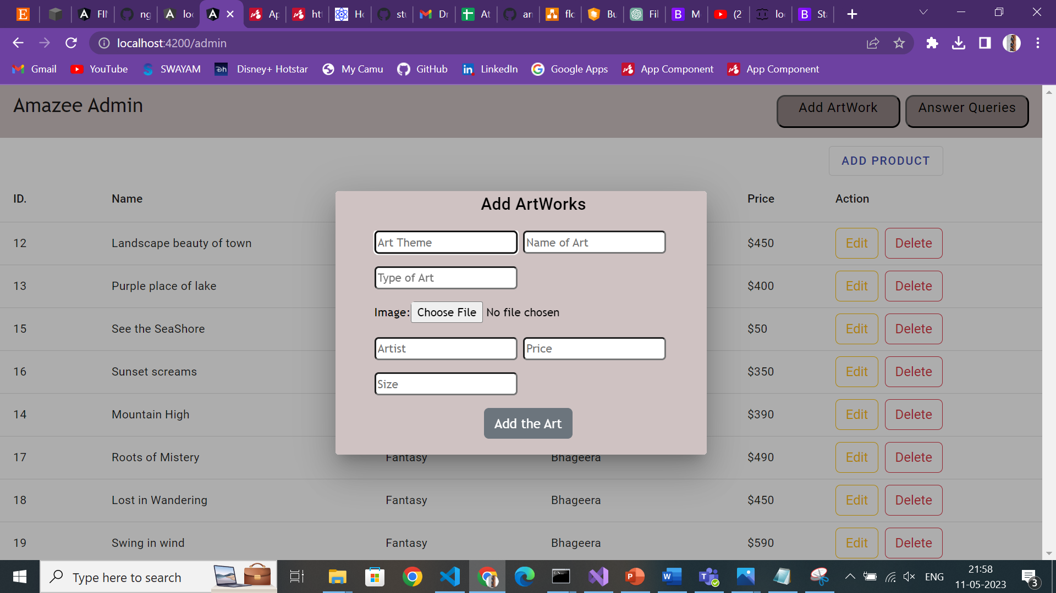
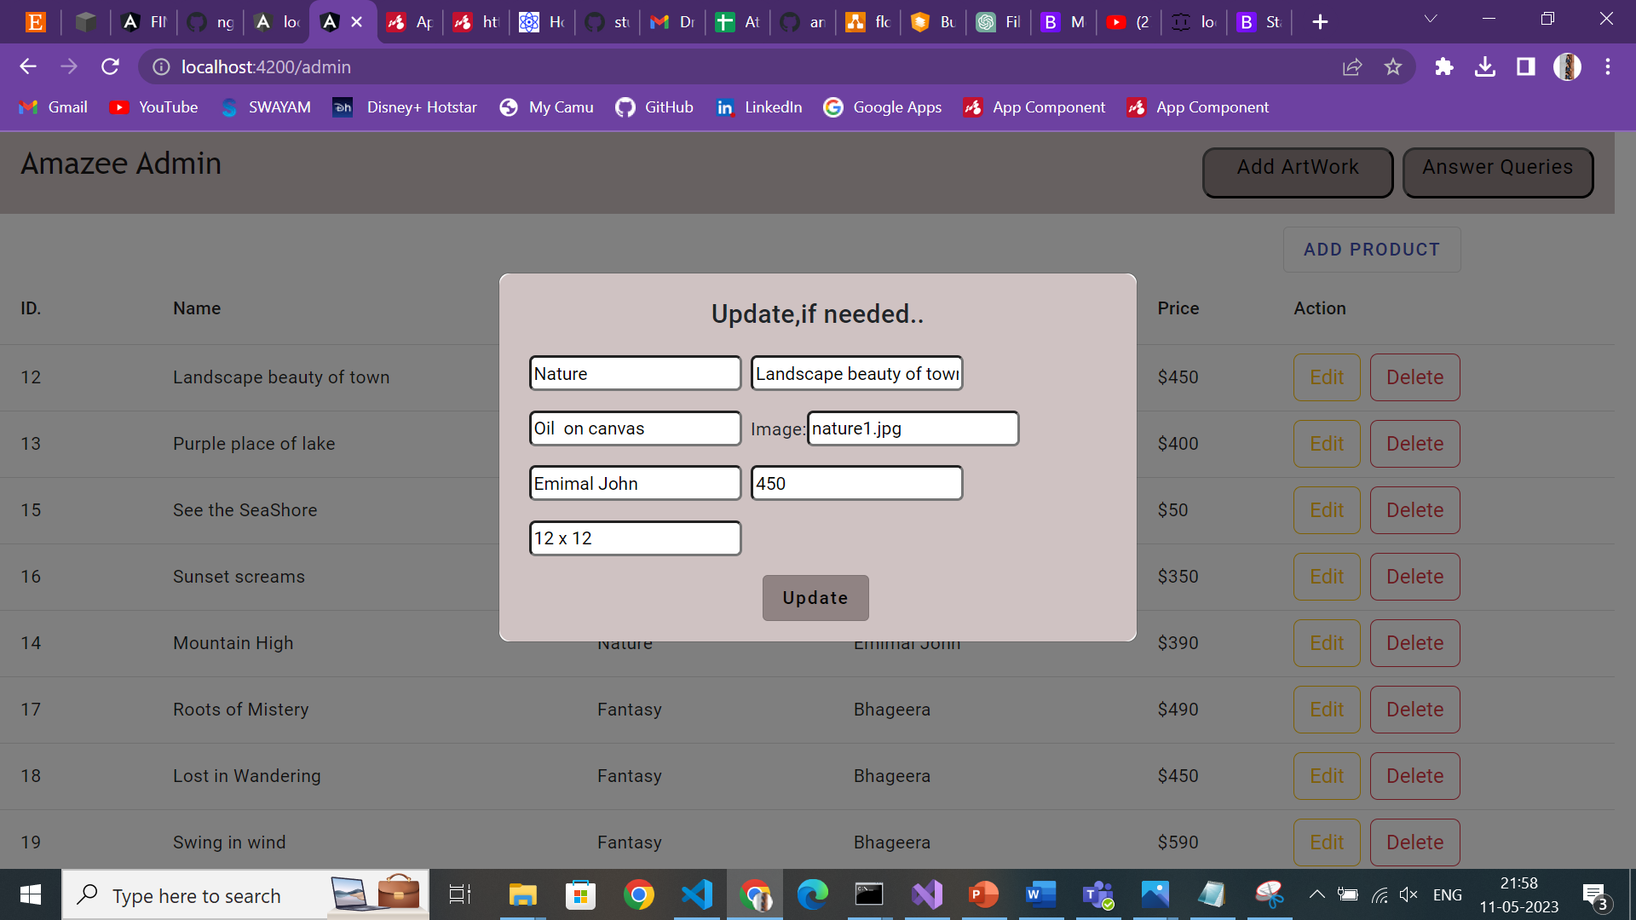
Used:
In Add Option-Post method
In Edit Option-Put and Get method
Mat Table
Add Product Dialog
Edit/Update Product Dialog

Slide 20
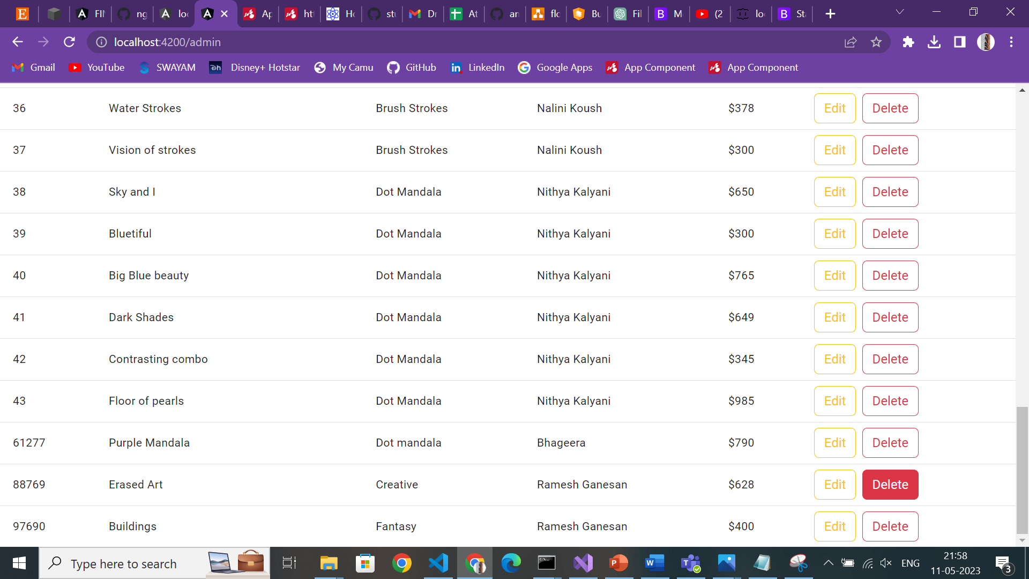
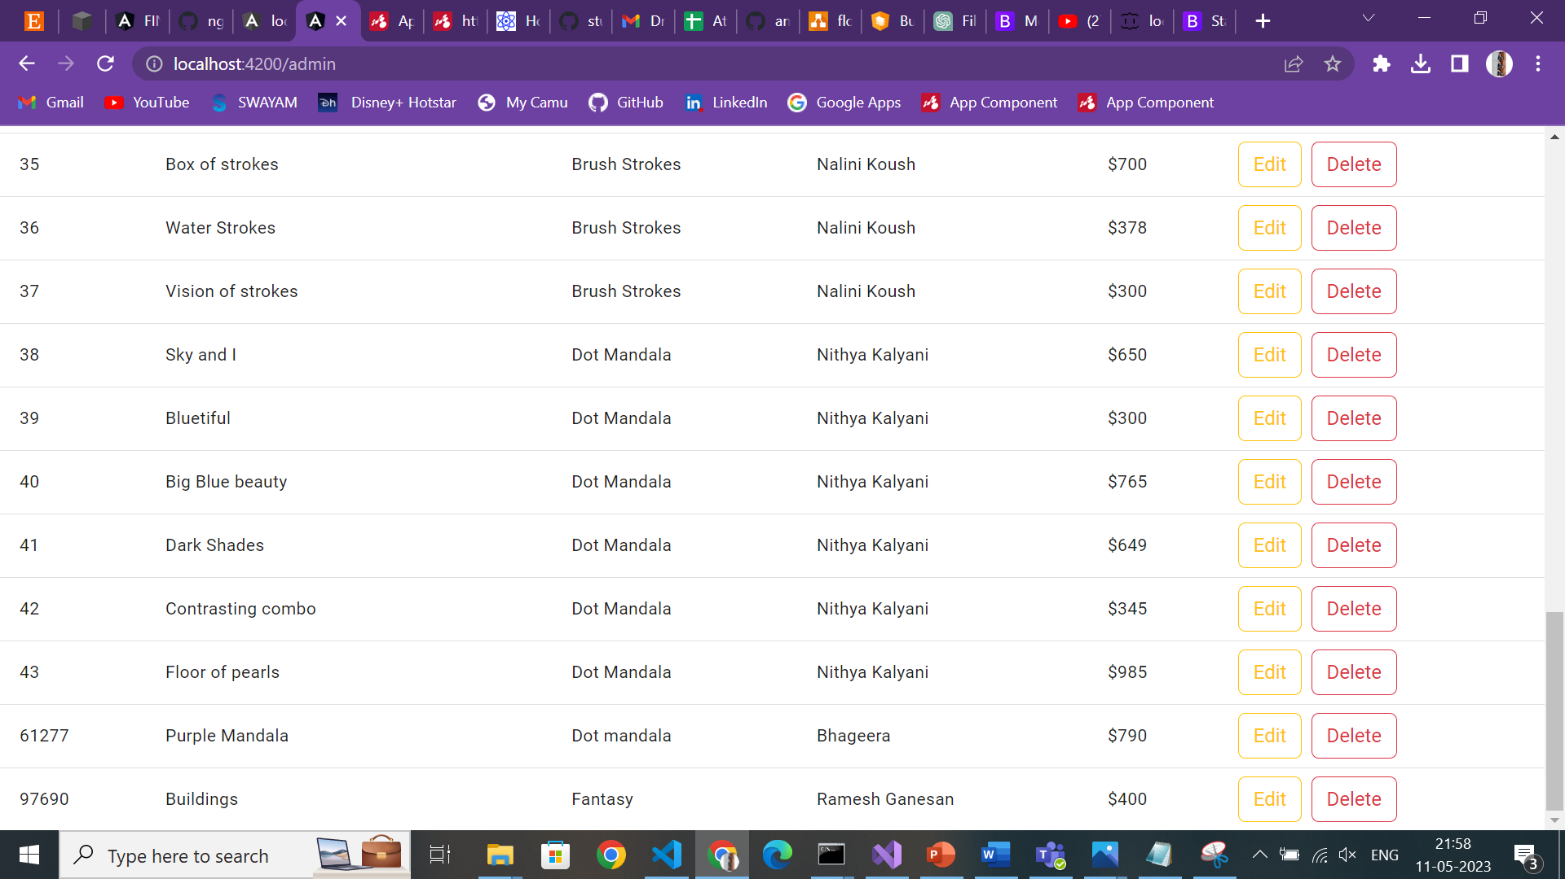
Used:
Delete Method
When Erased Art –delete button is clicked ,it erases the data from json and vanishes from table

Slide 21
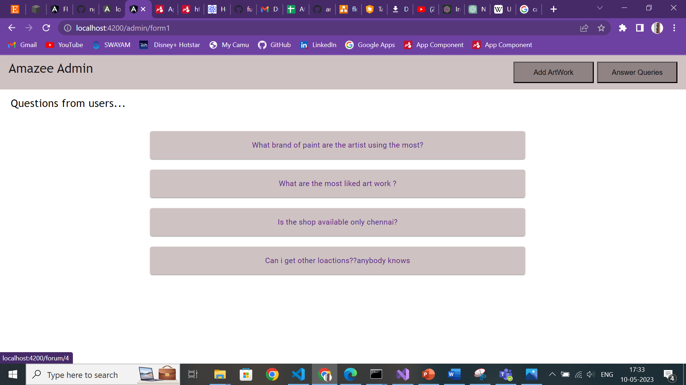
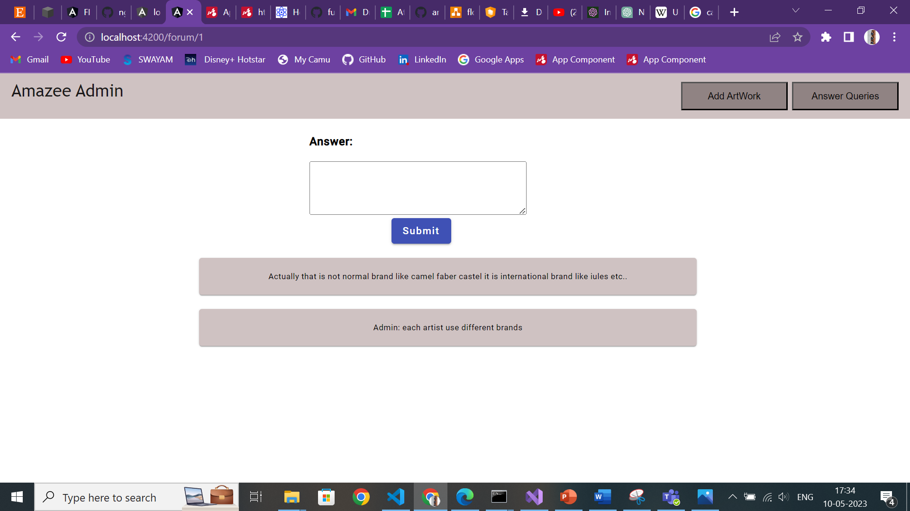

Slide 22
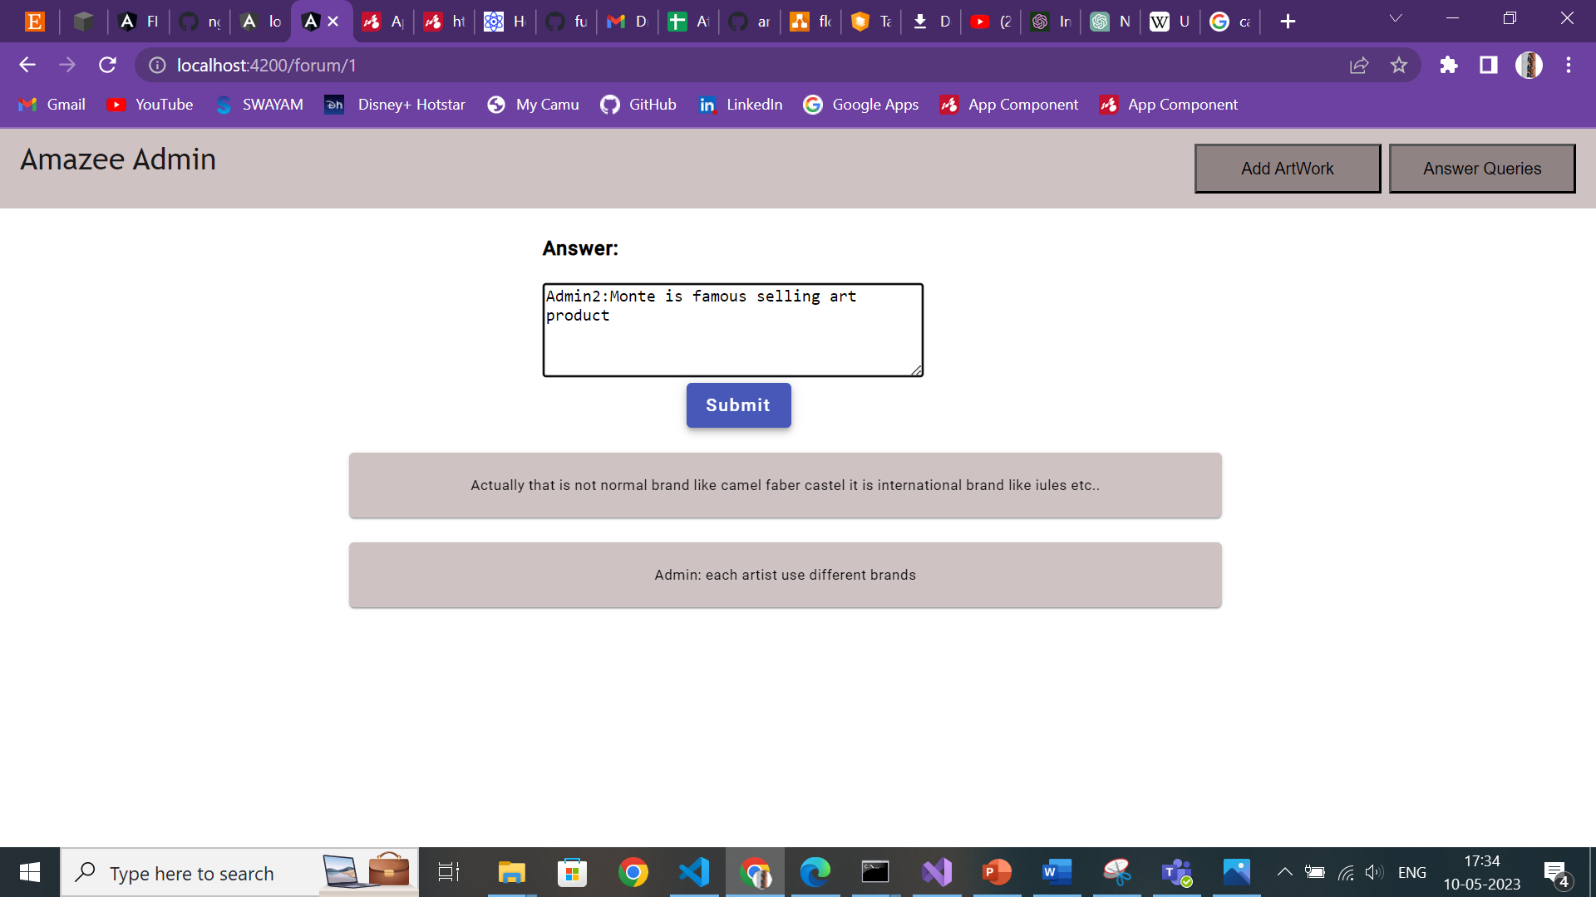
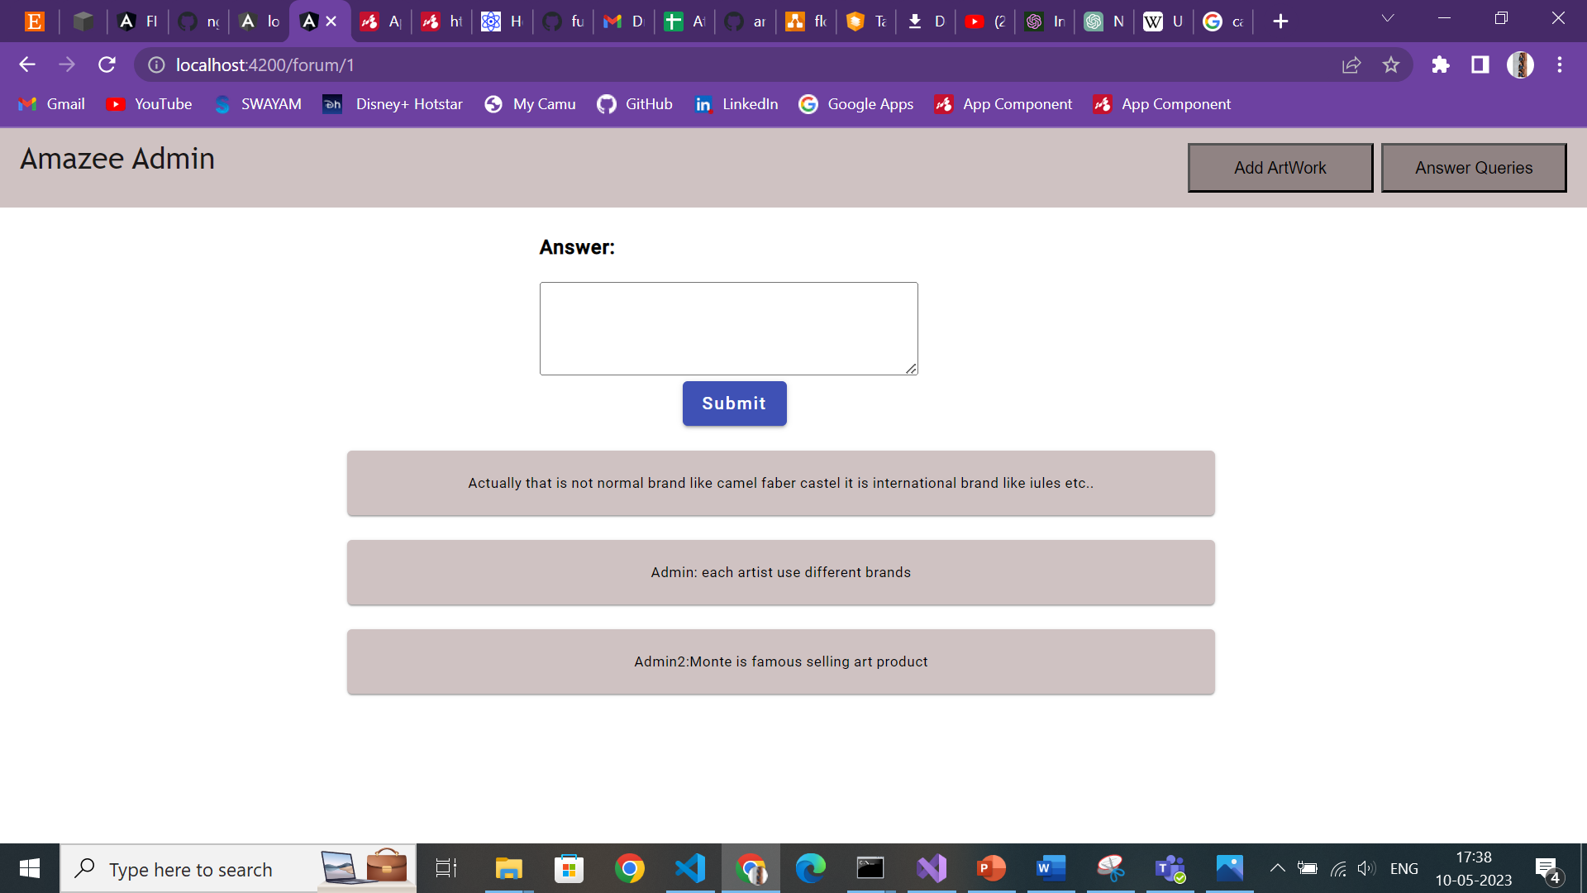

Slide 23

Requirement Satisfied:
1. you need to use Component heirarchy effectively - parent-child
2. Must use services
3. Data should be maintained only in API [ JSon-server]
4. For UI components, Use Angular Material & if needed bootstrap
5. Must and should have routing involved
1. Routing modules - lazy loading must be used
2.Routing Parameters must be explored
6. Pipes must be used
7. Template based and Model based approach should be used for Form handling
Value Addition - 30%
Security implementation
Multiple user flow [ like admin flow and user flow]
Effective handling of multiple modules
Internationalization
Custom Directives
Complex Feature implementation

Slide 24
Thank You

